Slide 1
Stock trade and analyst system
Stock trade and analyst simulator
based on desktop with windows OS.
Developed by Quan Xing, Guofeng Wu

Slide 2
Background:

Slide 3
Overview:
Analyst Chart
Paper trading
Portfolio management
Watch list

Slide 4
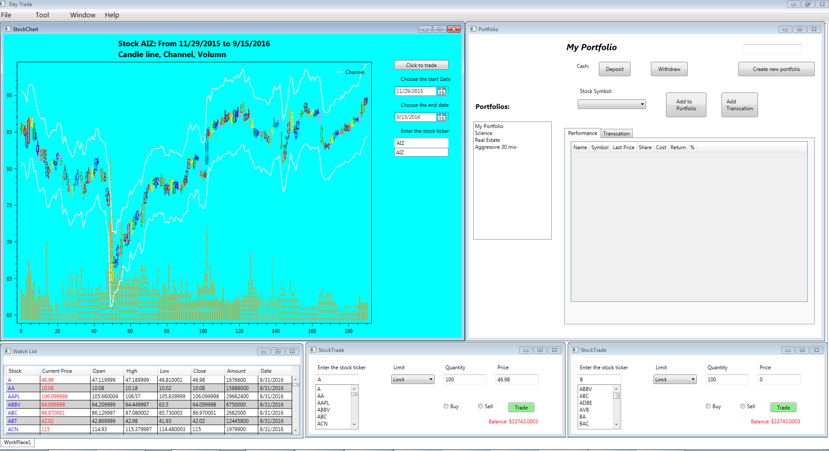
GUI:

Slide 5
Problem 1:
Install new library, try DynamicDataDisplay, Visifire, WPF Toolkit, Xceed Toolkit Plus.
Set the oxyPlot library which is 2D plot open code generation library

Slide 6
Problem 2:
candle line, no rectangle in library
( oxyPlot: 2D plot generation library )
draw by myself with price calculation

Slide 7
Problem 3:
check quantity and cost by stock ticker
write the right query without extra data.
Set action buy=1, sell=-1 , none = 0

Slide 8
Problem 4:

Slide 9
Screen shot

Slide 10
Screen shot

Slide 11
Screen shot

Slide 12
Screen shot

Slide 13
Screen shot

Slide 14
Future work
Live data
Trend Lines on Chart
Print
Layout design
Account
Position
Risk analyst

Slide 15
Summary

